Slide 1
Neuromorphic Computer Hardware
MS Project: Midterm Presentation
Khritish Kumar Behera
Roll: 17125, Email: khritish17@iiserb.ac.in
Electrical Engineering and Computer Science [EECS] Dept.
Indian Institute of Science Education and Research [IISER] Bhopal
Advisor: Dr. Kuntal Roy, Email: kuntal@iiserb.ac.in
Team:
M Mohanlal Naik, PhD Student,
Priyesh Kumar, PhD Student

Slide 2
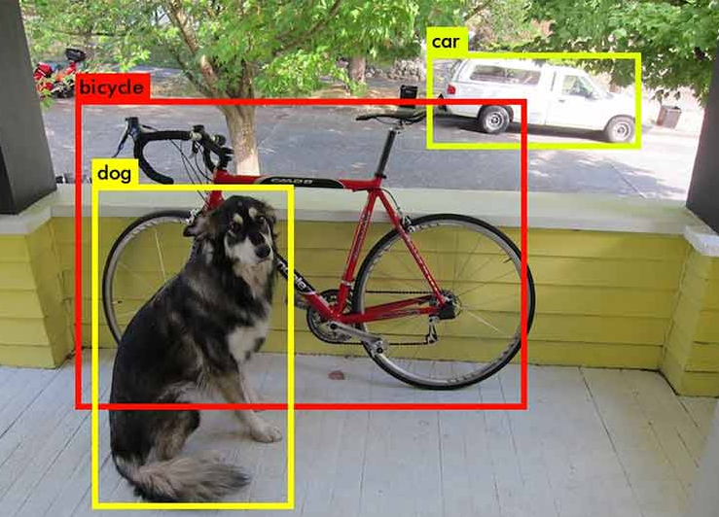
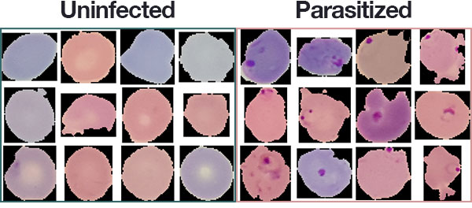

Artificial Neural Network: Motivation
Malaria Detection [2]
Object Detection and Object Identification [1]
Face Recognition [3]
Sources:
https://miro.medium.com/max/1400/1*IrptRDRG8IL9o-55BKjbLA.png
https://hackster.imgix.net/uploads/attachments/1073216/dl_medical_imaging_malaria_dataset_8DrQhbFeEr.jpg
https://miro.medium.com/max/875/1*x4nz_cq2ZX0pBrPjB6PLZg.jpeg
Khritish Kumar Behera

Slide 3
Artificial Neural Network: Perceptron
X1
W1
b
X2
W2
∑
σ
Y
X3
W3
Khritish Kumar Behera

Slide 4
Artificial Neural Network: Perceptron
X1
W1
b
X2
W2
∑
σ
Y
X3
W3
A Simple Perceptron can have more than one input but the output needs to be just one
Each input edge has a weight associated with it, which can be negative / positive / zero
Each node has a ‘bias’ term associated with it
The Neuron Process through two sequential processes: Summation and Activation
Khritish Kumar Behera

Slide 5
Artificial Neural Network: Perceptron
X1
W1
b
X2
W2
∑
σ
Y
X3
W3
A Simple Perceptron can have more than one input, but the output needs to be just one
Each input edge has a weight associated with it, which can be negative / positive / zero
Each node has a ‘bias’ term associated with it
The Neuron Process through two sequential processes: Summation and Activation
Khritish Kumar Behera

Slide 6
Artificial Neural Network: Perceptron
X1
W1
b
X2
W2
∑
σ
Y
X3
W3
A Simple Perceptron can have more than one input, but the output needs to be just one
Each input edge has a weight associated with it, which can be negative / positive / zero
Each node has a ‘bias’ term associated with it
The Neuron Process through two sequential processes: Summation and Activation
Khritish Kumar Behera

Slide 7
Artificial Neural Network: Perceptron
X1
W1
b
X2
W2
∑
σ
Y
X3
W3
A Simple Perceptron can have more than one input, but the output needs to be just one
Each input edge has a weight associated with it, which can be negative / positive / zero
Each node has a ‘bias’ term associated with it
The Neuron Process through two sequential processes: Summation and Activation
Khritish Kumar Behera

Slide 8
Artificial Neural Network: Perceptron
X1
W1
b
X2
W2
∑
σ
Y
X3
W3
A Simple Perceptron can have more than one input, but the output needs to be just one
Each input edge has a weight associated with it, which can be negative / positive / zero
Each node has a ‘bias’ term associated with it
The Neuron Process through two sequential processes: Summation and Activation
Khritish Kumar Behera

Slide 9
Artificial Neural Network: Perceptron
W1
Calculates the weighted inputs
Summation of Weighted inputs
Adds the bias term
Applies the activation function
X1
b
X2
W2
∑
σ
Y
X3
W3
Khritish Kumar Behera

Slide 10
Artificial Neural Network: Perceptron
W1
Calculates the weighted inputs
Summation of Weighted inputs
Adds the bias term
Applies the activation function
X1
b
X2
W2
∑
σ
Y
X3
W3
X1.W1 X2.W2 X3.W3
Khritish Kumar Behera

Slide 11
Artificial Neural Network: Perceptron
W1
Calculates the weighted inputs
Summation of Weighted inputs
Adds the bias term
Applies the activation function
X1
b
X2
W2
∑
σ
Y
X3
W3
( X1.W1 + X2.W2 + X3.W3 )
Khritish Kumar Behera

Slide 12
Artificial Neural Network: Perceptron
W1
Calculates the weighted inputs
Summation of Weighted inputs
Adds the bias term
Applies the activation function
X1
b
X2
W2
∑
σ
Y
X3
W3
( X1.W1 + X2.W2 + X3.W3 + b)
Khritish Kumar Behera

Slide 13
Artificial Neural Network: Perceptron
W1
Calculates the weighted inputs
Summation of Weighted inputs
Adds the bias term
Applies the activation function
X1
b
X2
W2
∑
σ
Y
X3
W3
σ( X1.W1 + X2.W2 + X3.W3 + b)
Khritish Kumar Behera

Slide 14
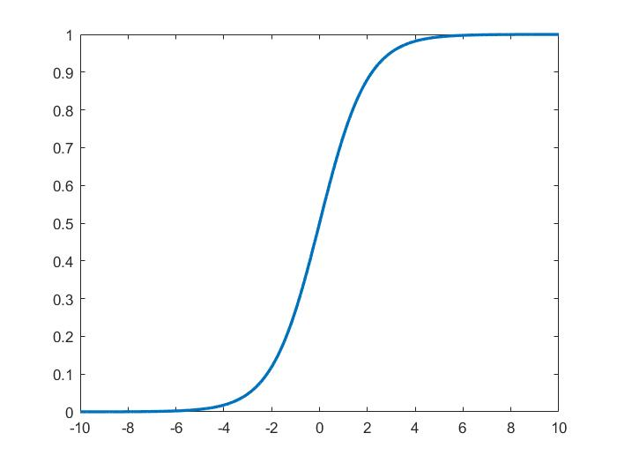
Artificial Neural Network: Activation Function
Activation Function is a non-linear mathematical function
Inspired from our biological Neuron
Non-linearity is the key to success for an ANN
Khritish Kumar Behera

Slide 15
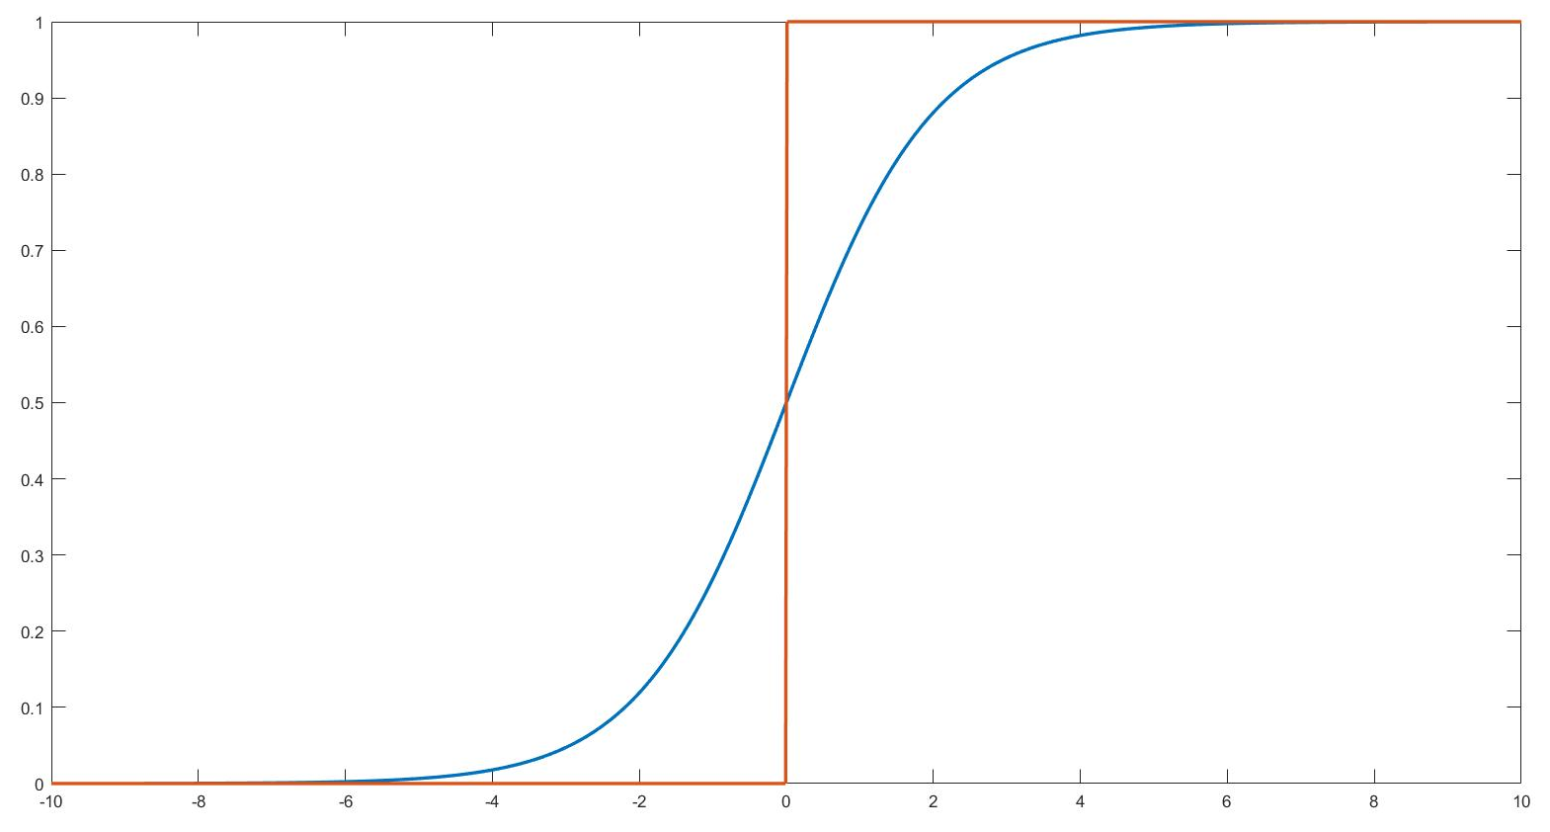
Artificial Neural Network: Activation Function
Activation Function is a non-linear mathematical function
Inspired from our biological Neuron
Non-linearity is the key to success for an ANN
Khritish Kumar Behera

Slide 16
Artificial Neural Network: Activation Function
Activation Function is a non-linear mathematical function
Inspired from our biological Neuron
Non-linearity is the key to success for an ANN
The Yellow circle and the red square are linearly classifiable
The Yellow circle and the red square are not linearly classifiable, only a non-linear classifier is able to classify them
Khritish Kumar Behera

Slide 17
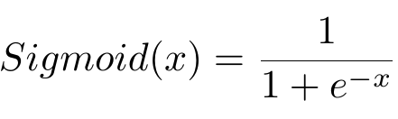
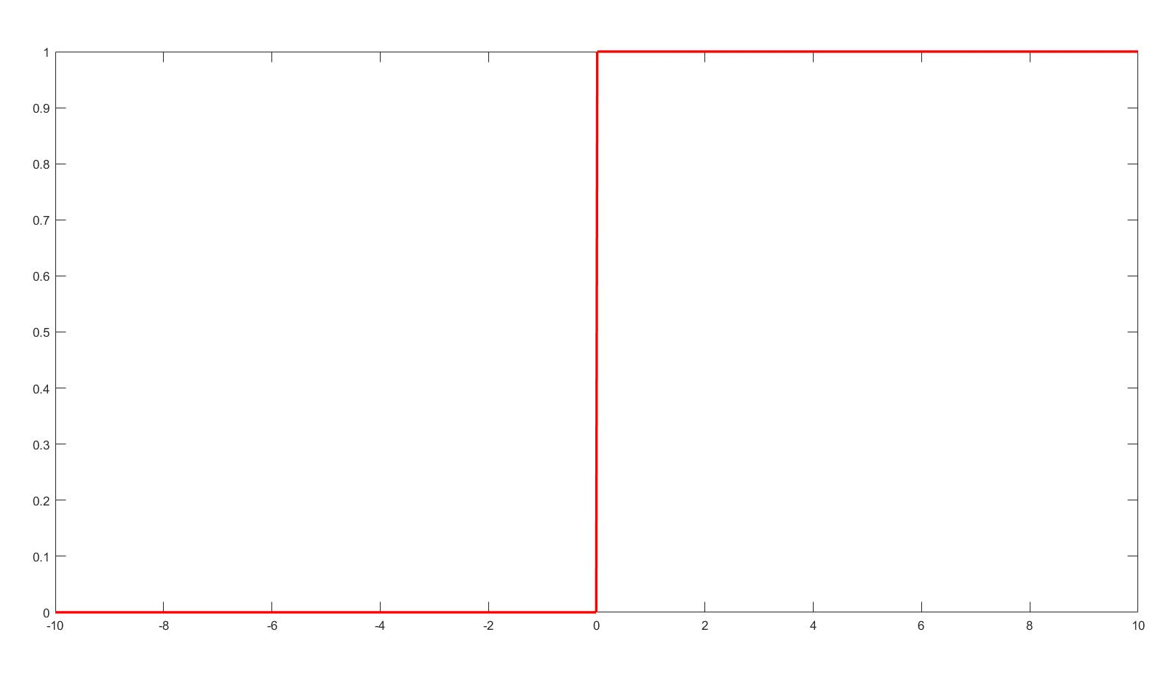
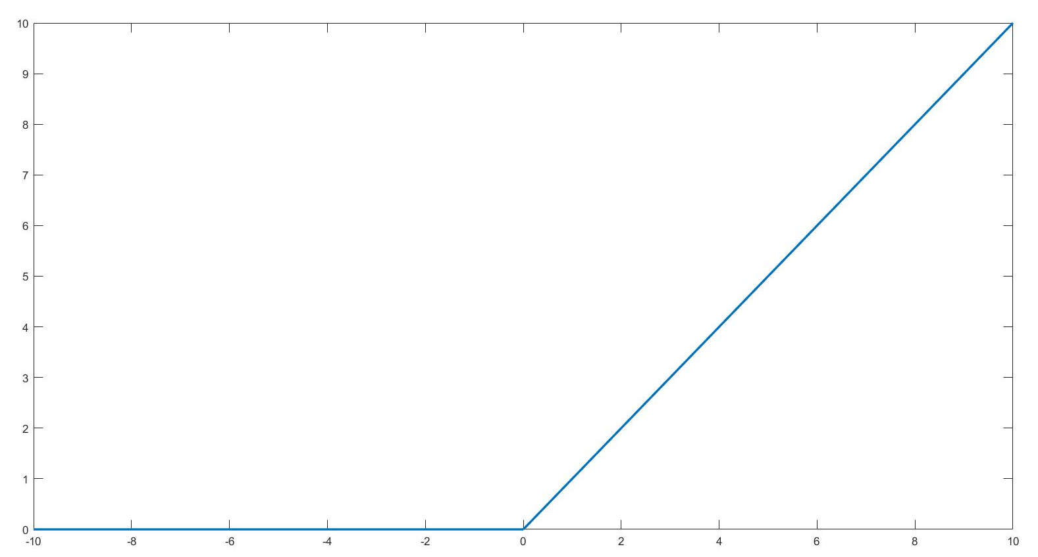
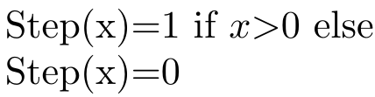
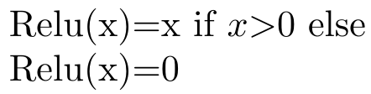
Artificial Neural Network: Activation Function
Activation Function is a non-linear mathematical function
Inspired from our biological Neuron
Non-linearity is the key to success for an ANN
Khritish Kumar Behera

Slide 18
Artificial Neural Network: Simple ANN
2
4
1
5
3
Khritish Kumar Behera

Slide 19
Artificial Neural Network: Simple ANN
2
4
An Artificial Neural Network is a system of connected artificial neurons
1
Generally divided in many layers
5
3
Khritish Kumar Behera

Slide 20
Artificial Neural Network: Simple ANN
2
4
An Artificial Neural Network is a system of connected artificial neurons
1
Generally divided in many layers
5
3
Output of each neuron of one layer is connected to the all of the neurons in the next layer
There are no self loops, no feedback loops
More than one edge emerging out of a neuron, does not mean that there are multiple output of the neuron
Khritish Kumar Behera

Slide 21
Artificial Neural Network: Simple ANN
2
4
An Artificial Neural Network is a system of connected artificial neurons
1
Generally divided in many layers
5
3
INPUT LAYER:
Neurons in the input layer is the original input feed into the system
There has to be at least one input neuron in the Input Layer
Neurons in the Input Layer does not alter the input in any sense.
HIDDEN LAYER:
Neurons in the hidden layer alters the input it gets
There has to at least one hidden layer
There has to be at least one hidden neuron in each hidden layer
OUTPUT LAYER:
Number of the neurons in the output layer depends on the problem
It is the layer which finally gives output to the end user
Khritish Kumar Behera

Slide 22
Artificial Neural Network: Forward Propagation
2
W1
W3
b2
1
4
Y
X
b4
W2
W4
3
b3
Khritish Kumar Behera

Slide 23
Artificial Neural Network: Forward Propagation
2
W1
W3
b2
1
4
Y
X
b4
W2
W4
3
b3
Khritish Kumar Behera

Slide 24
Artificial Neural Network: Forward Propagation
X.W1
2
W1
W3
b2
1
4
Y
X
b4
W2
W4
3
X.W2
b3
Khritish Kumar Behera

Slide 25
Artificial Neural Network: Forward Propagation
σ(X.W1+ b2)
2
W1
W3
b2
1
4
Y
X
b4
W2
W4
3
σ(X.W2+ b3)
b3
Khritish Kumar Behera

Slide 26
Artificial Neural Network: Forward Propagation
2
W1
W3
σ(X.W1+ b2).W3
b2
1
4
Y
X
b4
W2
W4
3
σ(X.W2+ b3).W4
b3
Khritish Kumar Behera

Slide 27
Artificial Neural Network: Forward Propagation
2
W1
W3
σ[σ(X.W1+ b2).W3 +σ(X.W2+ b3).W4 + b4]
b2
1
4
Y
X
b4
W2
W4
3
b3
Khritish Kumar Behera

Slide 28
Artificial Neural Network: Gradient Descent
Error
Initial Point
K = K - slope.LR
K (Optimizing Parameter)
LR : Learning Rate
Khritish Kumar Behera

Slide 29
Artificial Neural Network: Gradient Descent
Error
K (Optimizing Parameter)
Khritish Kumar Behera

Slide 30
Artificial Neural Network: Backpropagation
2
W1
W3
b2
1
4
Y
X
b4
W2
W4
3
Here we assume that the weights and biases are not optimized
b3
Khritish Kumar Behera

Slide 31
Artificial Neural Network: Backpropagation
2
T
W1
W3
b2
1
4
Y
X
b4
W2
W4
3
Error(E): T - Y
b3
Khritish Kumar Behera

Slide 32
Artificial Neural Network: Backpropagation
2
W1
W3
E
b2
1
4
Y
X
b4
W2
W4
3
Error(E): T - Y
b3
Khritish Kumar Behera

Slide 33
Artificial Neural Network: Backpropagation
E.W3/(W3 + W4)
2
W1
W3
E
b2
1
4
Y
X
b4
W2
W4
3
Error(E): T - Y
E.W4/(W3 + W4)
b3
Khritish Kumar Behera

Slide 34
Artificial Neural Network: Char. Recog.
We wish to create an ANN which can recognize alphabets from a noisy 7x5 pixel binary pattern
A
A
Khritish Kumar Behera

Slide 35
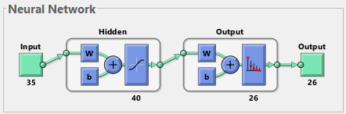
Artificial Neural Network: Char. Recog.
Khritish Kumar Behera

